Slide 2
Platformen
Optioneel: Pluggable Authentication Modules (PAM)

Slide 3
Pluggable Authentication Modules (PAM)
UNIX/Linux user accounts: beveiligd met wachtwoord in /etc/shadow, /etc/master.passwd of een netwerk database;
Programma’s vragen om een “geldig” account;
PAM “regelt” de toegang van o.a.”:
Biometrie, multi-factor authenticatie, systeem en programma toegang;
PAM is authenticatie methode / proces:
Methode specifieke authenticatie libraries;
Authenticatie van gebruikers of programma’s roep PAM aan;

Slide 4
Using Directory Services for Login (3)
PAM:
Authenticatie routines in een ‘shared library’ welke door andere programma’s kan worden aangeroepen;
Een laag die communiceert tussen gebruikers en applicaties
Multi-factor authenticatie is mogelijk;
PAM Configuratie: (‘one-liners’):
Format: module-type control-flag module-path [ arguments ]
Volgorde belangrijk:
ww prompt voor validiteit check van ww;
Module-type: auth, account, session of password;
Control-flag: include, optional, required, requisite, sufficient;
Notes:
Blz. 591 en 592 boek

Slide 5
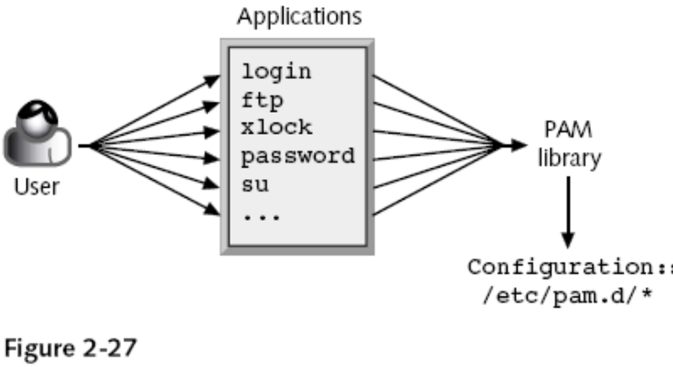
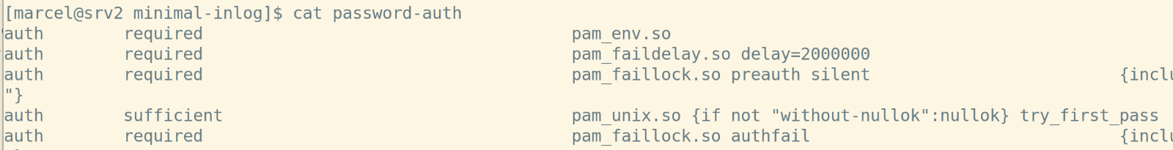
Hoe wordt PAM geconfigureerd?
PAM biedt verschillende modules
Lokatie van configuratie-bestanden
/etc/pam.d/<program_name>
Globale configuratie-bestanden directory
/etc/security
sudo authselect –help
sudo authselect list (voor de profielen!)
sudo authselect select minimal (profile selecteren)
sudo authselect create-profile minimal -b belangrijk (nieuw profile)
sudo authselect apply-changes

Slide 6
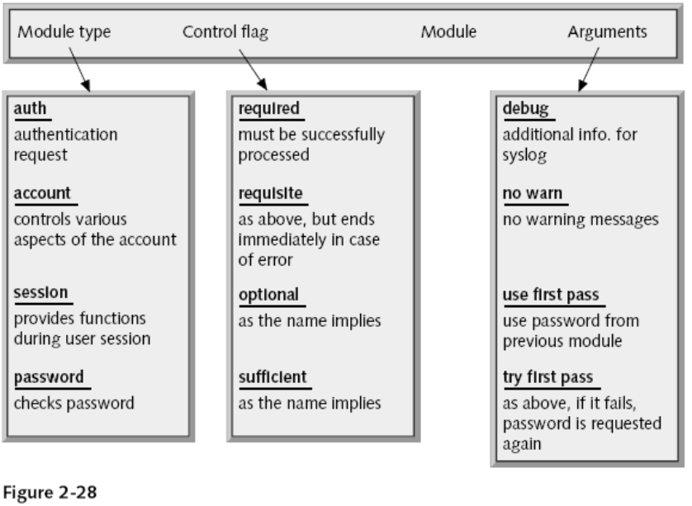
Hoe is de configuratie opgebouwd?
auth requisite pam_nologin.so
auth include common-auth
account requisite pam_nologin.so
account include common-account
password include common-password
session required pam_loginuid.so
session include common-session
Voorbeeld
(/etc/pam.d/sshd)

Slide 7
Wat zijn de standaard PAM modules?
Module | Doel | Module (cont’d) | Doel (cont’d)
pam_access | logdaemon style login access control | pam_namespace | setup a private namespace
pam_cracklib | checks the password against dictionary words | pam_nologin | prevent non-root users from login
pam_debug | debug the PAM stack | pam_permit | the promiscuous module
pam_deny | locking-out PAM module | pam_pwhistory | grant access using .pwhistory file
pam_echo | print text messages | pam_rhosts | grant access using .rhosts file
pam_env | set/unset environment variables | pam_rootok | gain only root access
pam_exec | call an external command | pam_securetty | limit root login to special devices
pam_faildelay | change the delay on failure per-application | pam_selinux | set the default security context
pam_filter | filter module | pam_shells | check for valid login shell
pam_ftp | module for anonymous access | pam_succeed_if | test account characteristics
pam_group | module to modify group access | pam_tally | ogin counter (tallying) module
pam_issue | add issue file to user prompt | pam_tally2 | login counter (tallying) module
pam_keyinit | display the keyinit file | pam_time | time controled access
pam_lastlog | display date of last login | pam_timestamp | authenticate using cached successful authentication attempts
pam_limits | limit resources | pam_umask | set the file mode creation mask
pam_listfile | deny or allow services based on an arbitrary file | pam_unix | traditional password authentication
pam_localuser | require users to be listed in /etc/passwd | pam_userdb | authenticate against a db database
pam_loginuid | record user's login uid to the process attribute | pam_warn | logs all PAM items
pam_mail | inform about available mail | pam_wheel | only permit root access to members of group wheel
pam_mkhomedir | create users home directory | pam_xauth | forward xauth keys between users
pam_motd | display the motd file

Slide 8
Vragen?
?

